Slide 1


IBM Bluemix Platform for Innovation
November 2016
Benoit Marolleau Architect – IBM Montpellier Client Center IBM France benoit.marolleau@fr.ibm.com

Slide 2
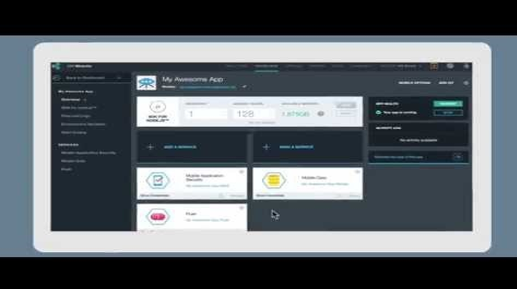
IBM Bluemix : The Digital Innovation Platform
https://www.youtube.com/watch?v=oOpPaz33KdA
Notes:
2

Slide 3


















App development today is about speed and choice
Steer
Design Thinking
DevOps
Continuous Feedback
Operate
Dev/Test
Mobile
Containers
Deploy
APIs
Tooling
IoT
Microservices
Runtimes
Extreme Agile
Cloud provides developers with instant access to the APIs, services and infrastructure they need to launch their ideas into the present.
Notes:
3

Slide 4
Timing is critical…
Today’s apps must keep up with the speed of the app revolution.
Core IT
Customer Managed
Code
Benefits
Fully customizable.
Necessary for some Business Critical solutions.
Leverage Existing Investments.
Data
Runtime
Middleware
Time Commitment
Weeks to setup and deploy.
Maintenance/upgrades of hardware and software.
OS
Virtualization
Servers
Storage
Networking
Time to initial deployment
~ Weeks
~ Days
~ Minutes

Slide 5



Timing is critical…
Today’s apps must keep up with the speed of the app revolution.
Customer Managed
Infrastructure as a Service
Service Provider Managed
Code
Benefits
Most control in the cloud.
Necessary for some solutions
Infrastructure managed by SP.
Data
Runtime
Time Commitment
Minutes to provision VM.
Time to configure software and apps varies.
Maintenance/upgrades of OS, middleware, runtime.
Middleware
OS
Virtualization
Servers
Storage
Networking
IBM SoftLayer
Core IT
Time to initial deployment
~ Weeks
~ Days
~ Minutes

Slide 6

Timing is critical…
Today’s apps must keep up with the speed of the app revolution.
Platform as a Service
Customer Managed
Service Provider Managed
Code
Benefits
Setup environments and deploy apps very quickly.
Infrastructure and platform managed by Service Provider.
Data
Runtime
Middleware
Time Commitment
Minutes to setup and deploy.
Focus on your apps and their data.
OS
Virtualization
Servers
Storage
Networking
IBM Bluemix
Core IT
IaaS
Time to initial deployment
~ Weeks
~ Days
~ Minutes

Slide 7
















Bluemix & Cloud Models
Capabilities in Bluemix now span PaaS and IaaS and can be delivered as a public, dedicated, or on-premises (private) implementation.
Traditional On-Premises
Infrastructure as a Service
Platform as a Service
Software as a Service
Applications
Applications
Applications
Applications
Data
Data
Data
Data
Runtime
Runtime
Runtime
Runtime
Middleware
Middleware
Middleware
Middleware
O/S
O/S
O/S
O/S
Virtualization
Virtualization
Virtualization
Virtualization
Servers
Servers
Servers
Servers
Storage
Storage
Storage
Storage
Networking
Networking
Networking
Networking
Client Manages
Vendor Manages in Cloud

Slide 8


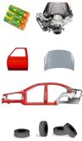
Application Life cycle in Traditional IT
Database
App Servers
Install
Configure
Integrate
…
OS
Virtualisation
HTTP Servers
Deploy
Dev
Test
QA/Staging/…
Production

Slide 9
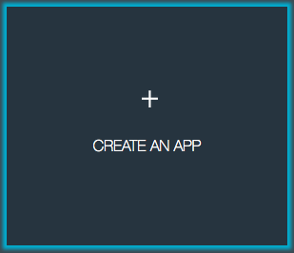

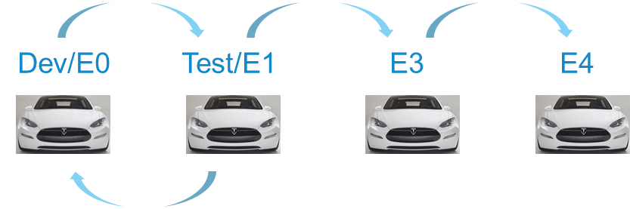

Application Life cycle: Managed Solution
Database
App Servers
OS
Virtualisation
HTTP Servers
Deploy

Slide 10





Use cases Example
“Reduce Turnaround times”
Bringing insight directly to their maintenance engineers via mobile
Using weather data to predict real time inventory needs
Sourcing new innovation from mobile developer communities
Notes:
Speaking Points:
Lets talk about some enterprise that have chosen to be disruptors
For instance the airline industry
Globally, over 100,000 planes take off every day – over 37 million flights last year
A plane alone has 360,000 parts.
Small margins - about $4 per passenger in 2012 – about the cost of a cup of large coffee
In the US alone flight delays cost over $8 billion in 2012
Making the right decision at the right time and place can make a huge difference.
A critical metric that airlines can control is Turnaround times – that’s how long it takes to turn an incoming flight into an outbound flight
For an Airbus A320, industry best practice is around 25 minutes.
But it’s not uncommon for turnaround time to take 45 minutes or more.
Every flight hour lost is about $10,000 of lost revenue.
Airlines are looking to adopt more efficient maintenance models
Airbus spoke on stage at InterConnect this year
saw this as an opportunity to transform the way they deliver value to their customers
moving beyond simply selling airplanes to offer new services that bring their expertise to their customers by bringing a wide variety of data and insight together to mobile devices in the hands of maintenance engineers to optimize the speed and efficiency of maintenance actions.
This requires dealing with a high number of diverse systems
some on premises
some in the cloud
some on planes in flight
some in the hands of maintenance engineers
It all has to come together so the people on the front lines can do their jobs more effectively.
They can bring all the pieces of the maintenance puzzle together:
The current location of the aircraft …
The maintenance history and real time maintenance status of the aircraft …
The availability of parts …
The location, availability and skills of the line mechanic … and more
By connecting and securing services and data from all these different sources, on the IBM Cloud, the three main players in aircraft maintenance
The mechanic
The maintenance supervisor
And Airbus
The right information gets to the right decision-makers at the point of action at the right time,
Accelerating troubleshooting
Shrinking Turnaround Time.
Keeping planes and people moving.
IBM Cloud and mobile bring it all together – the ability to bridge between the cloud and back office systems, mobile capabilities, analytics and security
DelHaize,
Parent company of Food Lion
Using nontraditional data, weather data in their inventory business process
To predict buying behaviors based on weather.
Just-in-time inventory based on answering open-ended business questions like weather that causes them to adjust their optimal goals continuously.
Citi spoke at Interconnect as well.
Fostering innovation through digital acceleration
Leverages the concept of outside-in innovation. Through it they want to:
Unleash the power of the tech community
Develop new solutions
Disrupt the way banks innovate
Recognized the missed opportunities that would exist if they relied solely on Citi and were unable to engage the full tech community.
Using 3rd party development communities to help drive innovation.
*****
This chart asks a simple question about disruption. 3 use cases of IBM customers and how disruptors affected them are provided here.
Airbus is about predictive maintenance (http://www-03.ibm.com/software/businesscasestudies/hr/hr/corp?synkey=F096557H25377L74)
Delhaize is about just in time inventory (http://www-03.ibm.com/software/businesscasestudies/ca/en/corp?synkey=S388250B30327K82)
Citi (http://www-03.ibm.com/press/us/en/pressrelease/46133.wss)

Slide 11

What is IBM Bluemix?

Slide 12

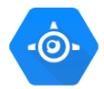



Bluemix is the IBM Platform As A Service offering
Bluemix provides mobile and web developers access to IBM software for integration, security, transaction, and other key functions, as well as software from business partners.
aPaaS (Application Platform As A Service) is a code deployment facility
aPaaS targets application developers from small or large organizations
Its purpose is to let them focus on writing business application and to write and deploy them quickly.
IBM Bluemix, Microsoft Azure App Service, Google App Engine, Heroku, OpenShift, Pivotal One are in this segment.

Slide 13




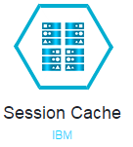
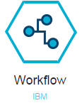
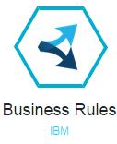
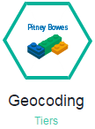
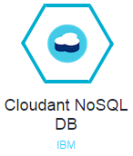
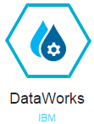
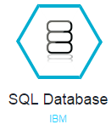
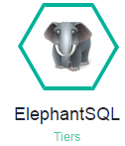
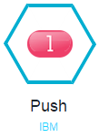
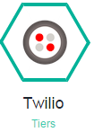

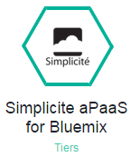
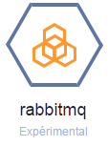
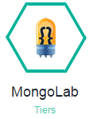
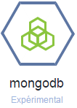
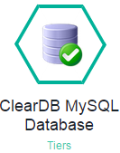
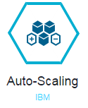
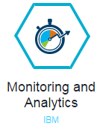

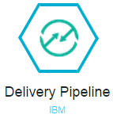
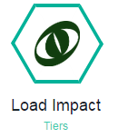
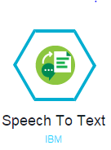
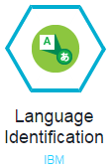
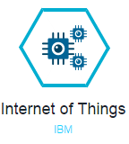
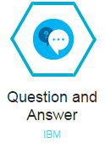
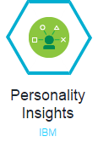
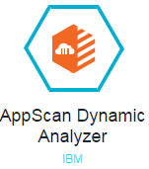
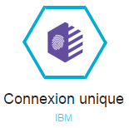
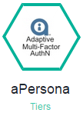
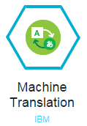
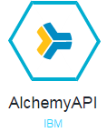
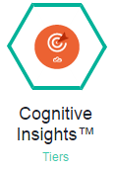
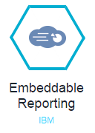
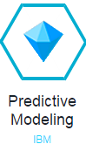
IBM Bluemix : A unique Service Offering!
+
Web
Data
Mobile
Cognitive
Business Analytics
IoT
Security
Your services!
Web & applications
Data Management
Mobile
+
DevOps
+
+
+
Cognitive *
IoT
Security
Business Analytics
+
+
* IBM Cognitive Services are based on IBM Watson

Slide 14






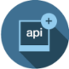













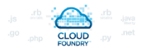







How does Bluemix work?
Bluemix is underlined by three key open compute technologies: Cloud Foundry, Docker, and OpenStack. It extends each of these with a growing number of services, robust DevOps tooling, integration capabilities, and a seamless developer experience.
DevOps
Tooling
Integration and API Mgmt
Your Own Hosted Apps / Services
Catalog of Services that Extend Apps’ Functionality
+
Web
Data
Mobile
Cognitive
Analytics
IoT
Security
Yours
Flexible Compute Options to Run Apps / Services
Instant Runtimes
+
Containers
+
Virtual Machines
+
Platform Deployment Options that Meet Your Workload Requirements
+
Bluemix
Public
Bluemix
Dedicated
Bluemix
Local*
+
Powered by IBM SoftLayer
In Your Data Center
14
*Bluemix Local coming Summer 2015

Slide 15
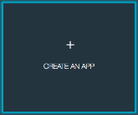
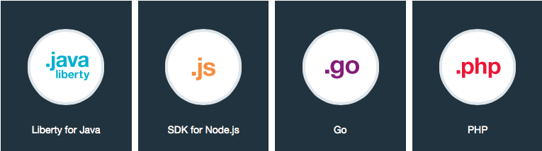
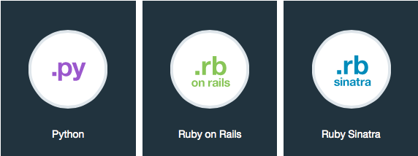

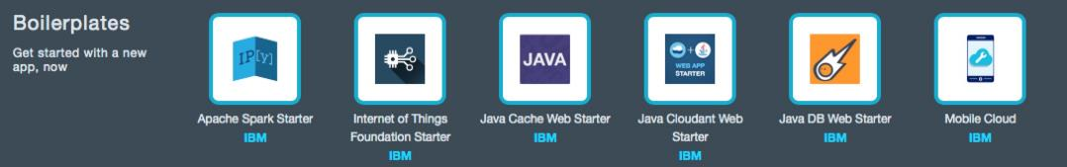
Bluemix PaaS
With Bluemix PaaS, installing and maintaining environment cost and overhead disappear.
Choose your runtime (Java, PHP, JavaScript, etc.).
Choose the services you need (IBM, community or third party services) from the Bluemix catalog.
Create your application & reduce your development cycle.
Or… use boilerplates !!
+
=

Slide 16

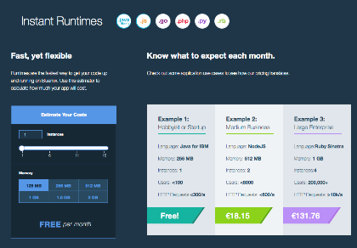
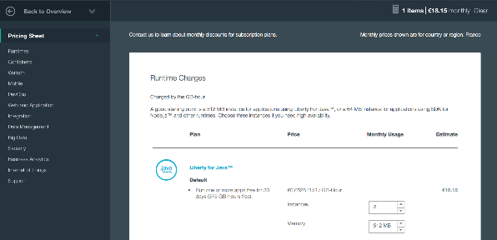
Billing
Pay as you Go (per GB, per service, per connected device, etc…)
More details on Bluemix: https://console.ng.bluemix.net/pricing/
Know what to expect each month: application use cases, estimators
(10/2015)
(10/2015)

Slide 17
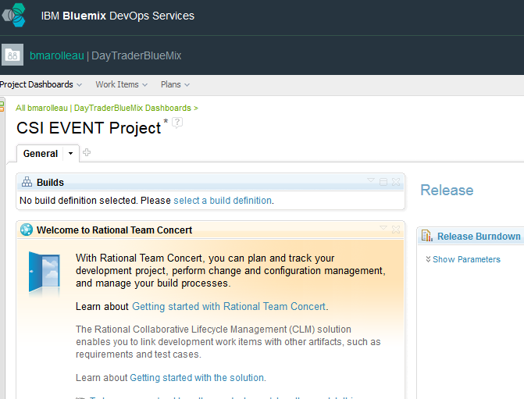
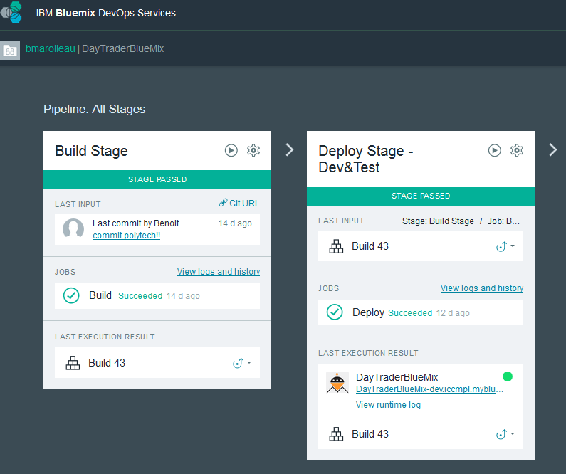

Bluemix Devops Services Integrated Agile Planning, Coding, Building, Deploying
TRACK & PLAN
Collaborative Tools Suite (SaaS) including:
Git Repository
Built-in Web IDE
Project Tracking & Planning (RTC)
Build & Deploy to Cloud Foundry / Bluemix
Dev Team Access Management
Can be used along with your existing IDE (Visual
Studio, Eclipse…)
Included in the Bluemix core features
How to get started:
https://hub.jazz.net/
http://www.ibm.com/cloud-computing/bluemix/devops/
BUILD & RUN
DEVELOP & SHARE

Slide 18
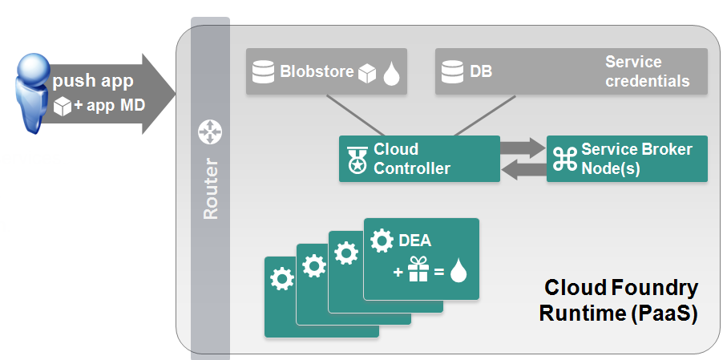
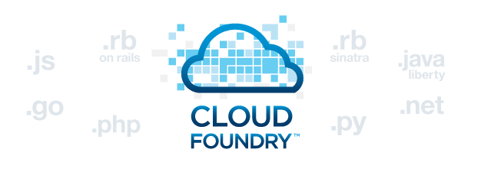
Bluemix PaaS: What’s happening at deployment? App Configuration & Deployment management
Developers can deploy, test & iterate very quickly
App component & metadata loading.
Services creation & bindings to the app.
Application instance setup (« staging »)
Application deployment.

Slide 19
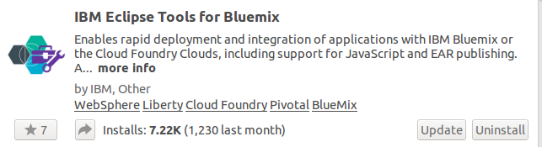
Eclipse Environment
Eclipse Java EE IDE for Web Developers. Find all releases here
Version: Mars Milestone 2 (4.5.0M2)
Plugin Install using:
Eclipse Help Menu > Eclipse Marketplace
Install "IBM Eclipse Tools for Bluemix" - Documentation Link
Install "Android Development Tools for Eclipse" for Android application development (Note: Android Studio is now the official IDE for Android Dev).

Slide 20

















Internet of Things & Predictive Maintenance with Power Systems and IBM Cloud [Cross Industry]
Value:
Quickly integrate IoT and extract value
Scenario….
Oil & Gas industry – Predictive Maintenance & Connected Pipelines
Integration of sensors of all kinds in all industries is becoming key, for event processing and pro-active actions… This demonstration illustrates an oil pipeline instrumentation with shock detection sensors and shock reporting in real time, alerting and asset management, and work order creation in the asset management solution based on sensors events.
Audience:
IT Mgr
Developer
HC Use Case:
SoR-SoE
Demonstration:
PaaS integration
Connected Pipeline
Industry:
Cross
Watson IoT
Events
IoT Box
http://demostepat.mybluemix.net/
MQTT
Bluemix Public
Diagnostic &
Predictive Maintenance
Demonstrated IBM Solutions
IBM Power system (Linux/AIX)
Bluemix Watson IoT
IBM Maximo integration with IoT
QB4MX
Link to Asset:
http://ibm.biz/IoT-StepAT-Ennovia-Cloud-Power

Slide 21
Promo Code – Polytech
Contact France: Gaelle Balteaux gaelle.balteaux@fr.ibm.com
Avoir accès gratuitement à IBMBluemix, c'est facile !
IBM propose un accès privilégié à Bluemix aux enseignants et à leurs étudiants :
Pour les enseignants :
Accès gratuit à Bluemix : 40 services + 8 GB de mémoire
Durée : 12 mois renouvelables
Pour les étudiants :
Accès gratuit à Bluemix : 10 services + 2 GB de mémoire
Durée : 6 mois renouvelables

Slide 22
Demo : Cognitive Job Finder

Slide 23






Cognitive Job Finder
Do you care about the future of young generations?
Do you have kids or do you know young people struggling to identify the Job they’d like to do?
Do you believe IBM Watson brings unique value & innovation and can help in fixing societal issues?
Did you experience difficulty to identify what job you wanted to do when you were young?
What is Job Finder Application?
JOBS SCORING matching candidate profile & Jobs + demand forecasting Jobs(in the 2 to 5 coming years)
TRAINING proposal & financial options
MENTOR assignment
Social media
Job Offerings
Personality
Preferences
Criterias
Candidate Profile
Jobs profiles
Schools
Market Predictions
Web-
mobile Apps
Compare

Slide 24








Cognitive Job Finder
Value Proposition
For Y&Z Generation
For Government
For Companies
Personal Assistant to find the right Job for the person
“Happiness at work” (one important motivation factor)
Savings by reducing unemployment (Cost of 1 unemployed person per year: 28737 € in France)
Impact on PIB (loi d’Okun)
Right person for the Job
Increase employees loyalty & reduce cost of turnover (70 % of Gen-Y leaves 1st job within 2 years of joining)
How ?
Bluemix
Selected Watson API
Data
Social media data
Candidate data
Market Trends Data
Job profile
Job offerings
Training offerings…
Mobile / Web Apps
IBM Systems -Analytics solutions
Personality Insights
Tradeoff Analytics
Insights for Twitter

Slide 25



Cognitive Job Finder
Link to the application & Video
JobFinder Application LINK
VIDEO

Slide 26


Slide 27











Job Finder - Development
Bluemix Organization
Space= PROD
Space= DEVTEST
Test
Application
QA TESTER
Deploy
Deploy
Build
IDE+ Deployment Pipeline
DevOps
Internet
Code
On Premise
Code & Build
IDE with Bluemix Plugin
DEVELOPER

Slide 28
Job Finder - Production Demo
Bluemix Organization
Space= PROD
Space= DEVTEST
Production Application
HA Scalability Low latency
Deploy
Deploy
Build
IDE+ Deployment Pipeline
DevOps
Internet
On Premise
IDE with Bluemix Plugin

Slide 29

Job Finder : From Dev to Prod
Bluemix Organization
Space= PROD
Space= DEVTEST
Application
Production Application
Test
HA Scalability Low latency
QA TESTER
END-USERS
Deploy
Deploy to Production in a Cloud Environment - Bluemix - Bluemix "Dedicated" - IaaS Infrastructure: Softlayer, other...
Deploy
Build
IDE+ Deployment Pipeline
DevOps
Deploy in a Private Cloud / On premise environment
Internet
Code
On Premise
Code & Build
Production Application
IDE with Bluemix Plugin
DEVELOPER

Slide 30

Want to know more?
Connect to Bluemix right now, create an IBM ID Account, and start developing!
Bluemix developerWorks Community
https://developer.ibm.com/bluemix/
Bluemix developerWorks Forum
https://www.ibmdw.net/answers/?community=bluemix
IBM Open Source on GitHub
http://ibm.github.io/
Top 9 rules for Cloud Applications
http://www.ibm.com/developerworks/websphere/techjournal/1404_brown/1404_brown.html
Building Highly Scalable Application for Bluemix
http://ibm.biz/ScalableApps-dW
Bluemix Webinar:
http://www.ibmcloudwebinars.com/fr

Slide 31





Website: ibm.com/ibm/clientcenter/montpellier/
Twitter: @IBMCCMPL
YouTube: IBM Client Center Montpellier
Pinterest: ibm-client-center-Montpellier
IBM connections: w3-connections.ibm.com/communities/community/ibmccmpl
Follow us!

